Slide 1

CloudSat data product introduction, analysis workflow, and ground clutter issue
Ding Li MMATH in Comp Math
Photo credit: @bruce.digital

Slide 2
What is CloudSat?
Active remote sensing using Cloud Profiling Radar (CPR)
94GhZ for observing clouds and precipitations
Not blocked, does not penetrate through, just fine
A-Train constellation with a minute-level time gap
Turned to C-Train (with CALIPSO) at the end of its lifespan

Slide 3
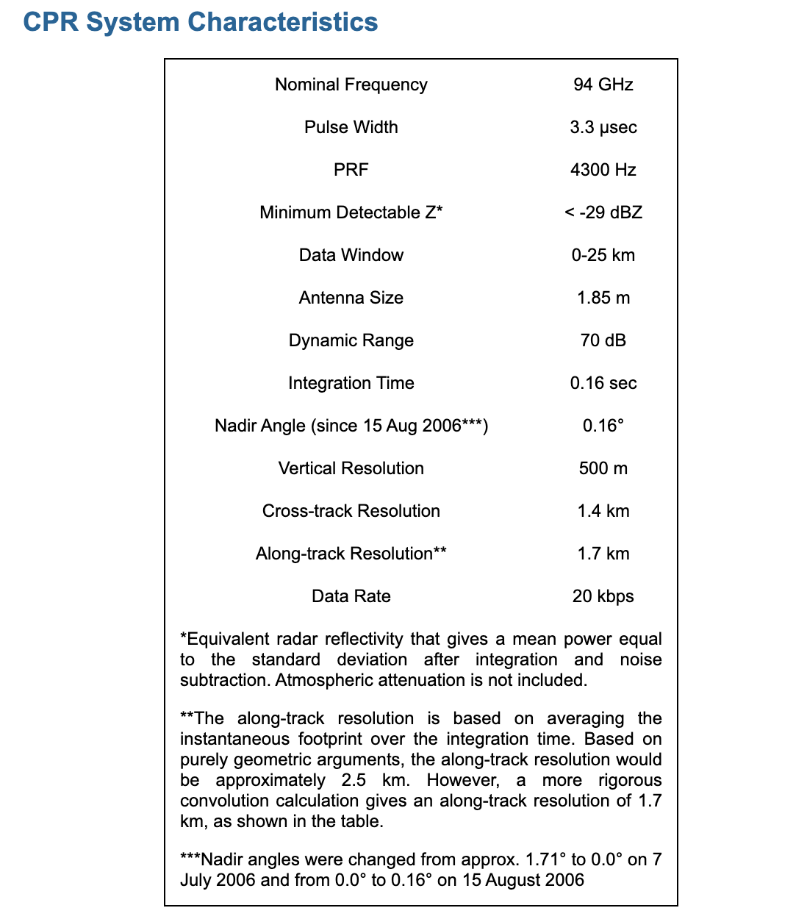
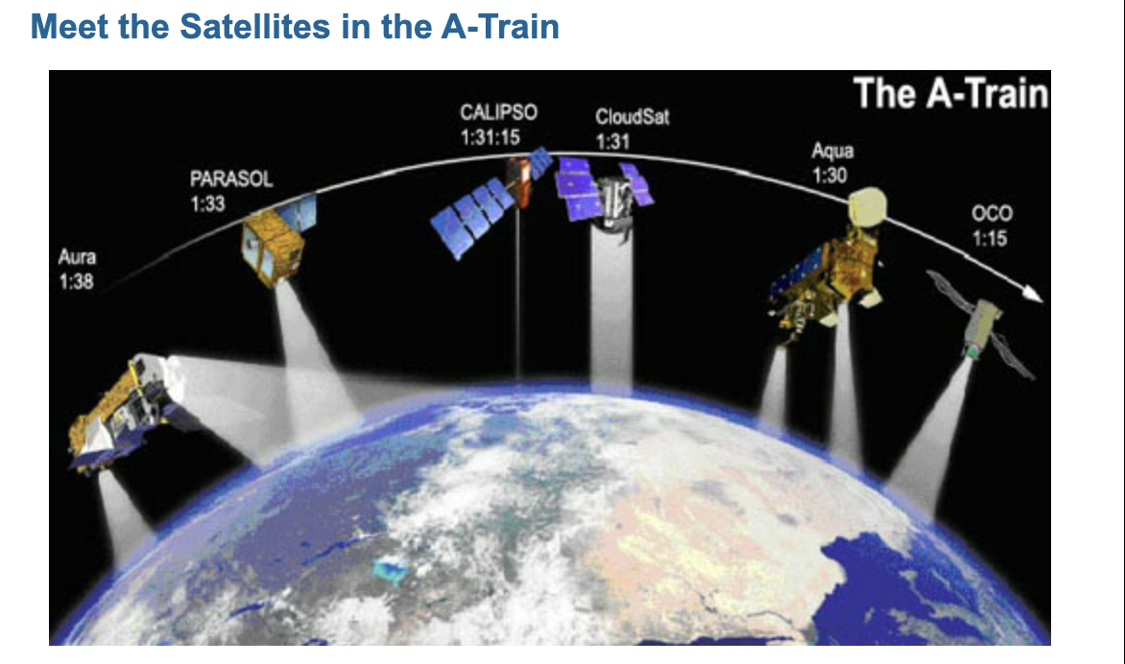

Slide 4
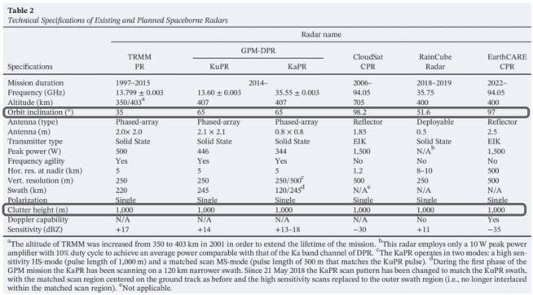
Comparison with other Cloud/Precip missions

Slide 5
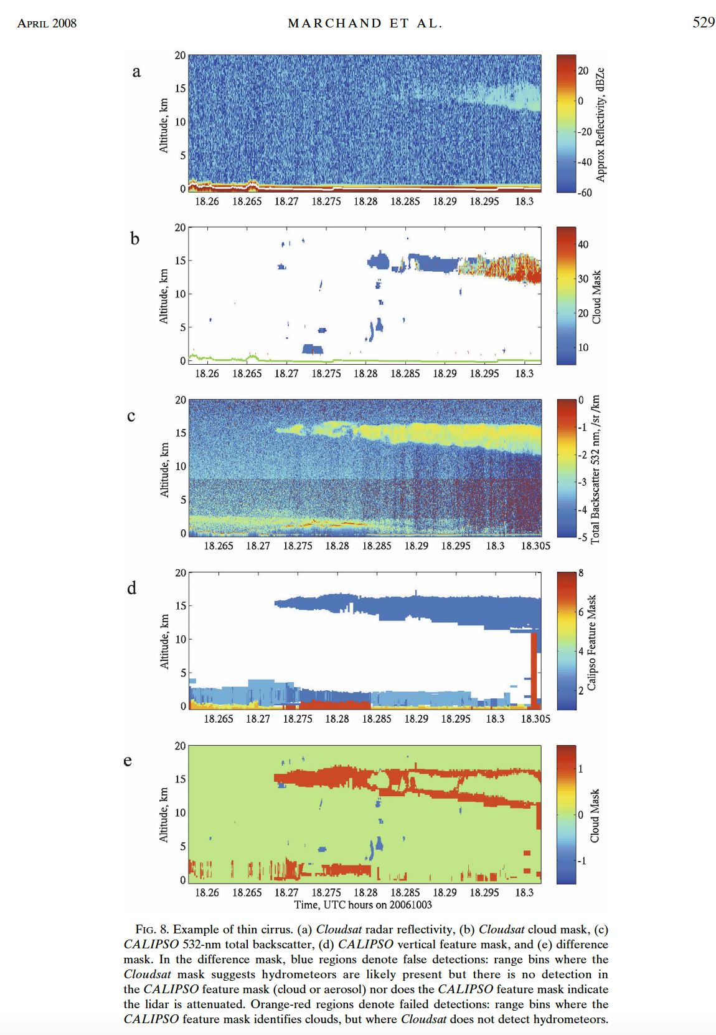
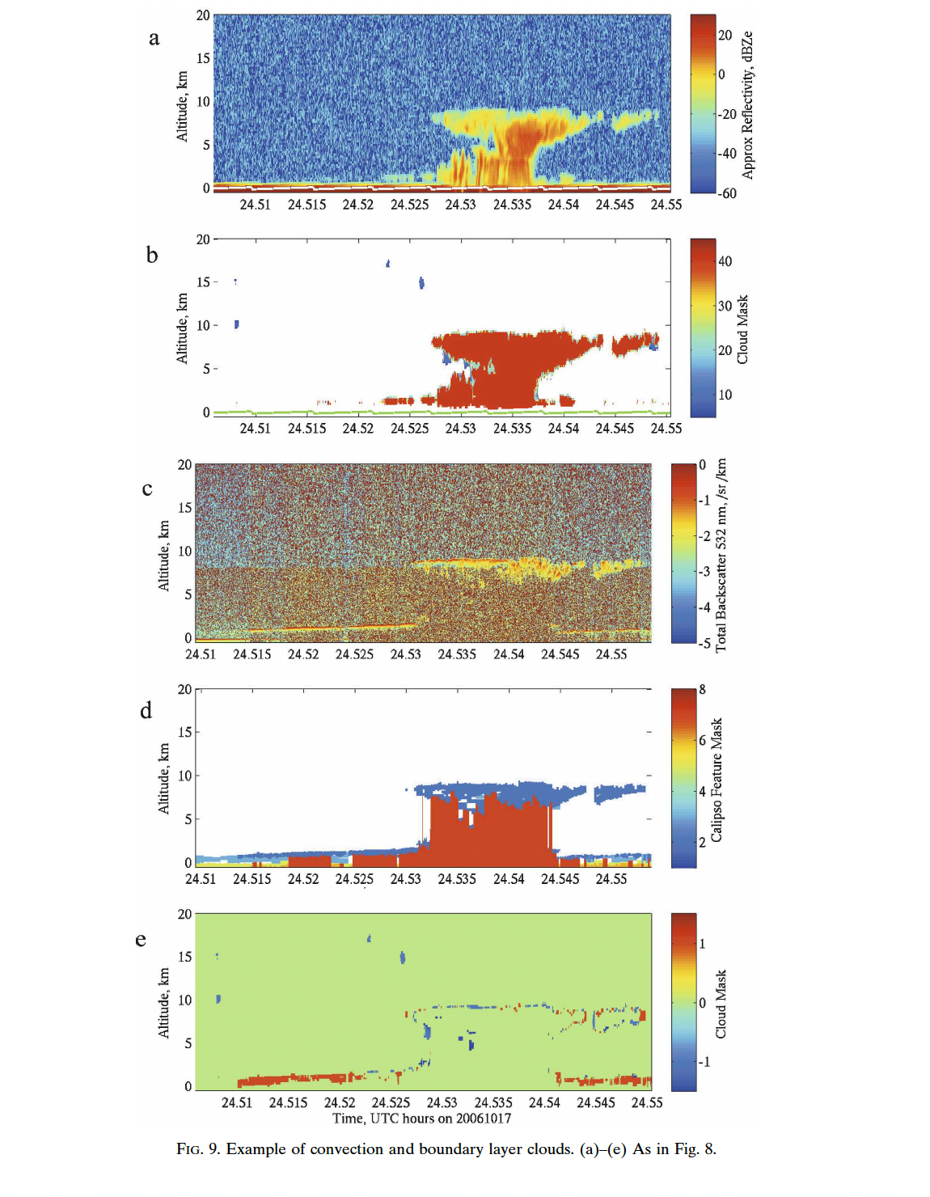

Slide 6
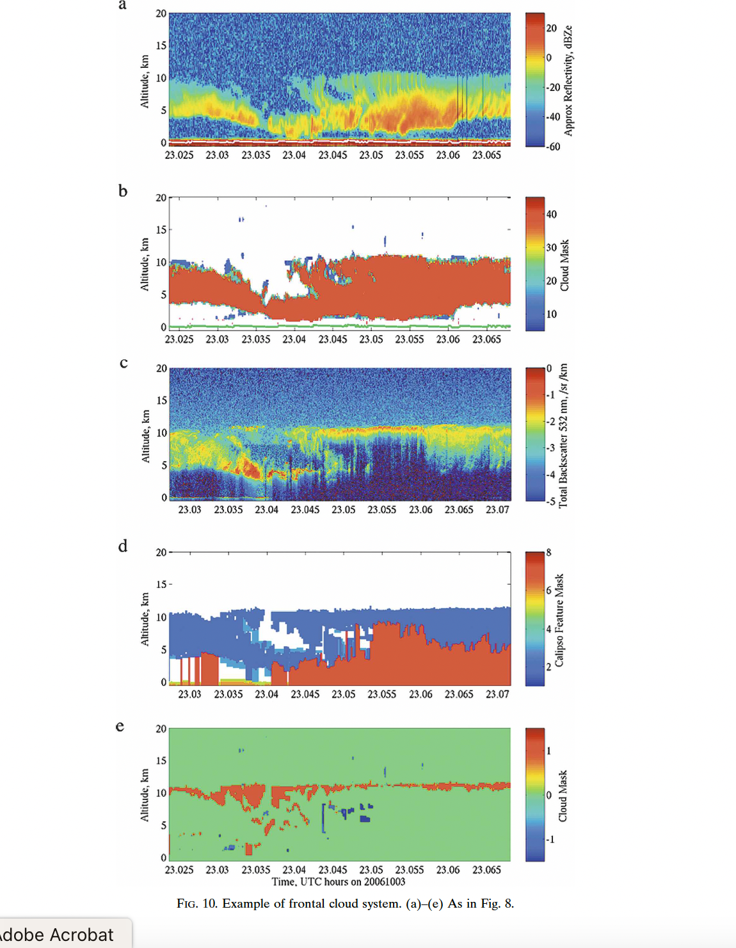

Slide 7
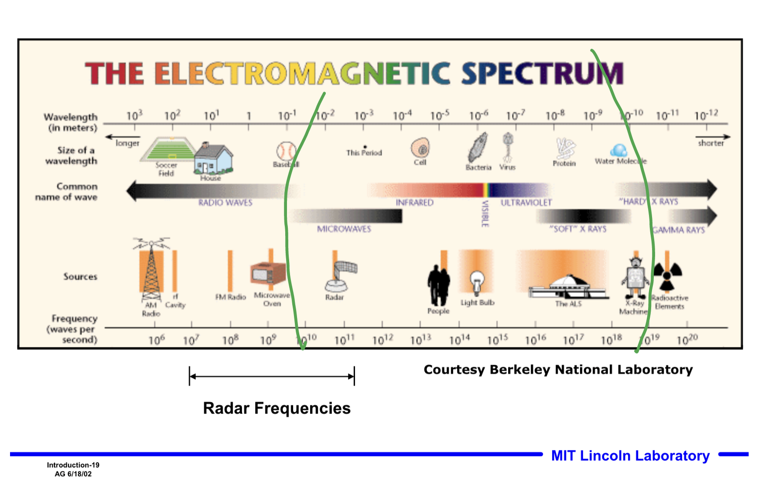

Slide 8
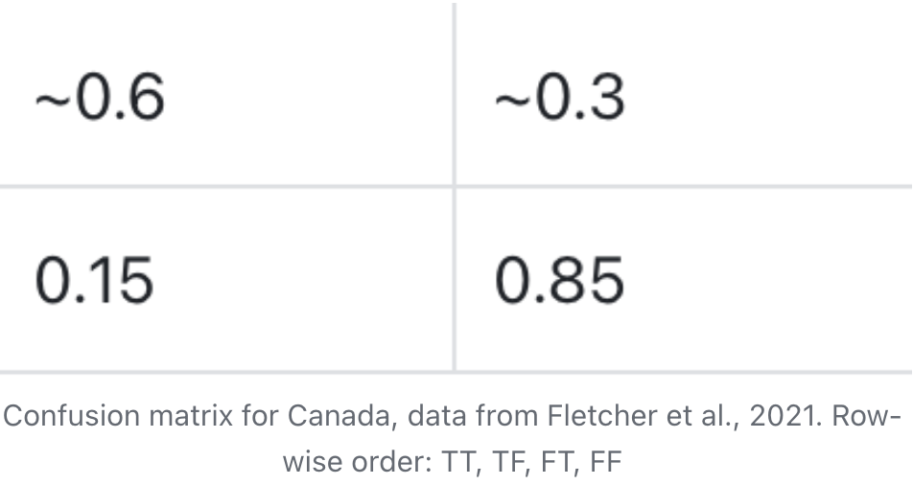
CPR is not good at:
detecting the occurrence of precipitations
High false detection
But once a precip indeed occurs, 80% we observe it
Thin clouds
Intensive water precipitations (due to attenuation)
Shallow clouds & Virga (due to ground clutter)
Combining CALIPSO Lidar data can be helpful
2B-CLDCLASS-LIDAR

Slide 9
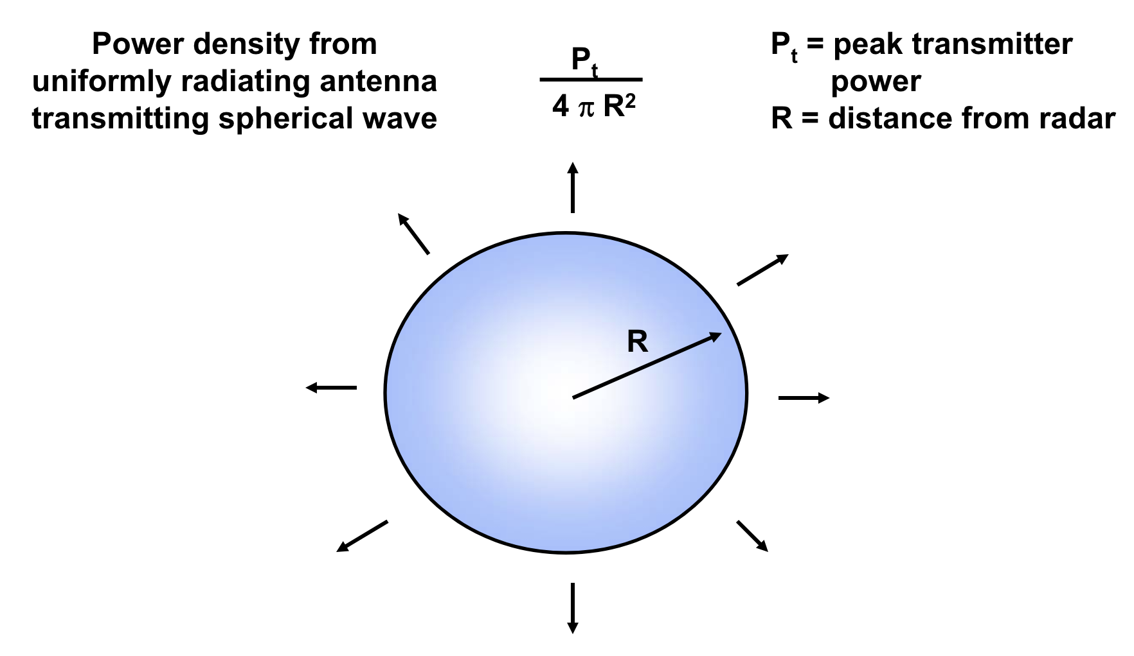
Key variables
CloudSat has a series of hierarchical data products
Levels: 0, 1B, 2B, 2C, Aux, etc.
Lower-level products are inputs for higher-level products
1B: Backscatter profiles
2B, 2C: Retrived energy/weather/climate profiles
Aux: Collocated data from other sources

Slide 10
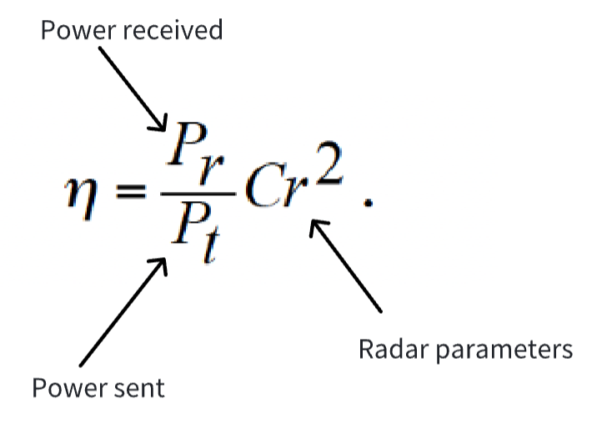
Key variables
Object backscatter echo (i.e., radar received echo), in Watts
How much sent energy is returned back (per unit time)?
What’s in the parameter?
E.g., The microwave transmits radially, antenna parameter determines the amount of power focused on the nadir direction

Slide 11
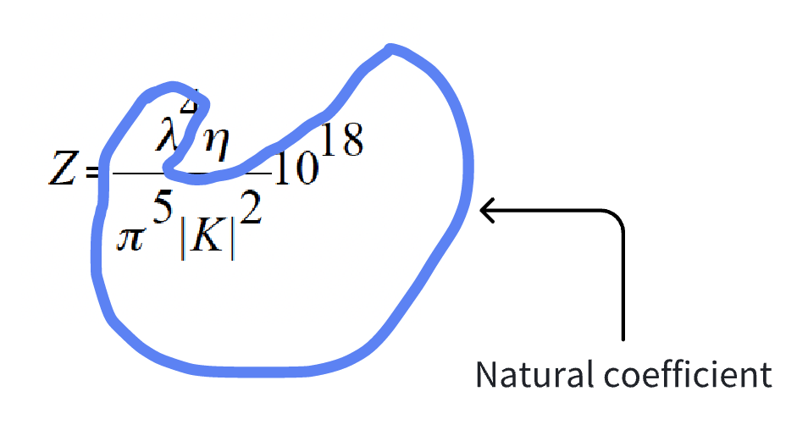
Key variables
Reflectivity, in dB, dimensionless:
Rescale backscatter echo by natural coefficients
Highlight the physical property of the illuminated target
The target backscatters, absorbs, and lets go different
proportion of energy, depending on its physical property
Why do we rescale?
Object-microwave interaction is a function of Dielectric constant
Now, microwave is fixed (to be 94Ghz), we need a reference object
Standard water dielectric as the reference

Slide 12
Key variables
Why do we use dBZe and apply other scalings rather than just Ze? Rescale Ze to a normal range [-4000, 5000] and good for extreme-value comparison
Very small signal will be expanded to a normal number
0.0000000001 -> -100
Very large signal will be shrunk to a normal number
10000000000000000 -> 160
Can distinguish between very small numbers and very large numbers:
Log(x*b) != log(x) + log(b) for extreme numbers numerically (machine epsilon in numerical analysis)
You need to distinguish very light hydrometeuors against very small noises!
You need to distinguish significant hydro echoes against very large ground clutter signals!

Slide 13
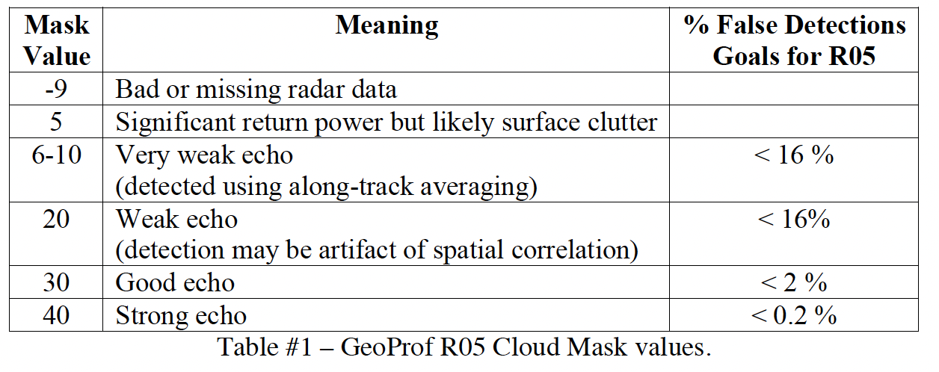
Key variables
CPR Cloud Mask: A basic classification for the detected signals
Determined by comparing to noise
Noise’s distribution for each ray is sampled from stratosphere
Assume a normal distribution with sample mean and standard deviation
5 classes: noise, noise + 1sd~2sd, noise + 2sd~3sd, noise + 3sd~4sd, noise + 4sd and above

Slide 14
Key variables
Snowfall rate
One-dimensional velocity of SWE, in mm/h
Use a complex model to retrieve

Slide 15
2C-SNOW
Use a Z-S relation to get S from observed Z
Idea:
Reflectivity of snowfall (Ze) is determined by its microphysical properties
Given the microphysical properties of the snowfall, we can get S
Therefore, we should:
Identify if a scene is snowfall
If it is, find its key microphysical properties
Then, use a forward model to retrieve its snowfall rate
Quantify the uncertainty according to the priori distribution

Slide 16
2C-SNOW
Scene characterization:
Remove blind zone
Find the whole precipitation layer if there is any
-15 dBZe threshold
Find the cloud layer of the precipitation
Verify the precipitation is snowfall

Slide 17
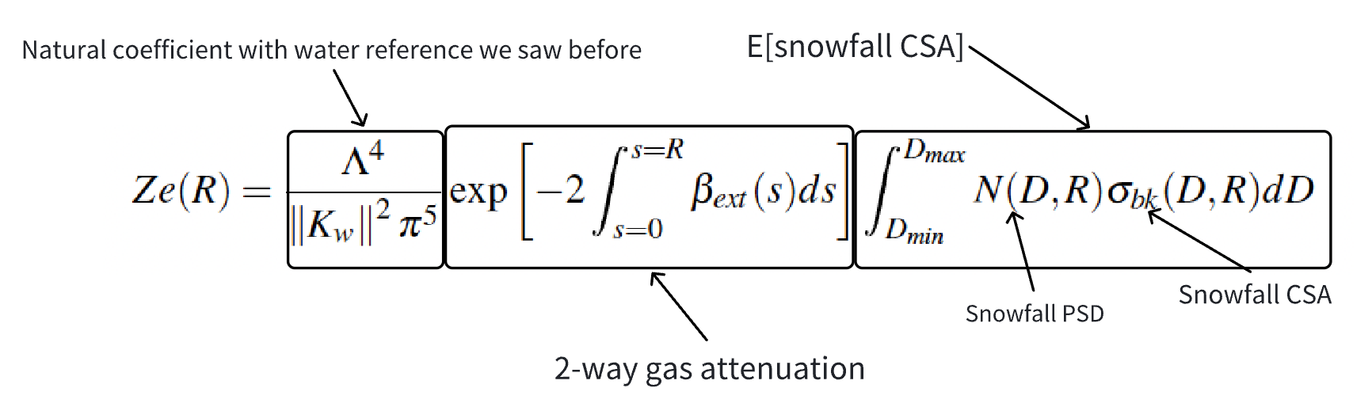
2C-SNOW
Ze-snowfall CSA relation:
The trainsmitted microwave experiences a 2-way atenuation along its path to the target
Only a little part of the remaining energy is backscattered by snowfall, dependent on the size of the backscattered -- PSD

Slide 18
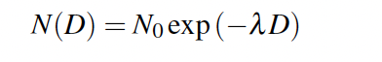
2C-SNOW
PSD parameterization:
PSD is assumed to be an exponential probability mass function
2 parameters: N and lambda
Hence, given observed Ze, we can get N and lambda using Maximum Likelihood Estimate

Slide 19
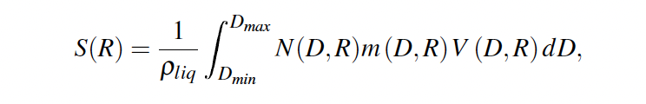
2C-SNOW
Forward model:
By using the MLE of the PSD, we can derive the S
Mass of the snow per unit time devided by water density

Slide 20
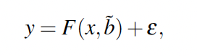
2C-SNOW
Uncertainty estimate:
Use a priori distribution to estimate the uncertainty
The distributional distance normalized by the precision matrix matrix (certainty) of the priori estimates how likely your result is reasonable
Get the optimal MLE of N, lambda by solving using Newton’s iterative method

Slide 21
Data analysis workflow
Data downloading:
DPC official data ordering system
Can select based on a spatial window
Maximum a 2-month time window
SFTP server
Register on the DPC website using your SSH and IP address
No restriction on downloading, but you can’t filter your data based on any criteria, i.e., time/space window, or any attributes

Slide 22
Data analysis workflow
Data format and parsing:
HDF-EOS binary data, not readable by people
1 hdf file == observation for 1 day == 14~15 orbits
Parsing methods:
Official toolkits
Convert to HDF5 through an official tool, then use pyhdf, etc.
MATLAB
CIS, a geoscience data integration platform developed by a team from Oxford

Slide 23
Data analysis workflow
A cloud computing platform develop by myself
On manabe now
Submit a query, wait, and get the result database under /mnt/obs
2 tables: 2D-attribute table (test2d) & 3D-attribute table (test3d)
Attributes with only horizontal profiles are in the 2d table
Attributes with a vertical dimension are in the 3d table
Can do “join” operation to combine connect them

Slide 24
Data analysis workflow
Data analysis:
The database is large: multiple GB for only one day of observation
Large-scale long-term study is challenging
You can’t read TB of data to your memory one time
Data loading is very slow
Speed benchmarking: connectorx >> hdf-file python packages > pandas
Solution to memory limitation:
Separate the data in chunks on the disk, run a for loop to load them in the memory batch-by-batch
Use pyspark or other advanced distributional computing packagesconnectorx

Slide 25
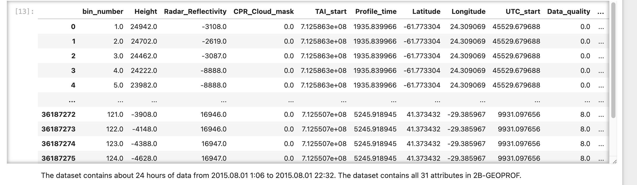
Data analysis workflow
Data analysis:
Statistical analysis: Tabular form is just fine for mainstream DS software, e.g., python, R, MATLAB, ArcGIS

Slide 26
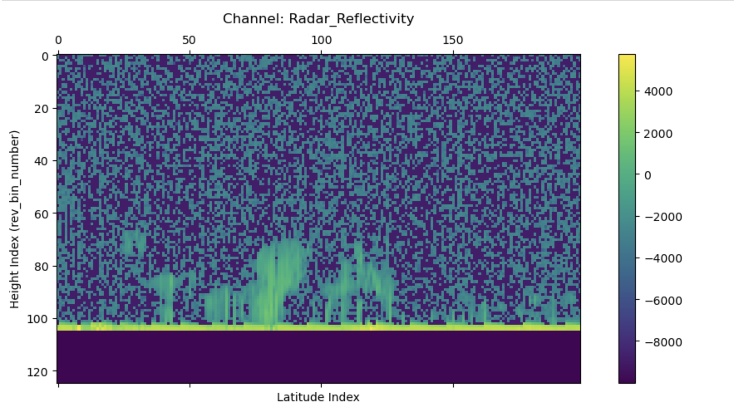
Data analysis workflow
Data analysis:
Image operations: Convert to raster data, e.g., tensor in mem, or geotiff on disk

Slide 27
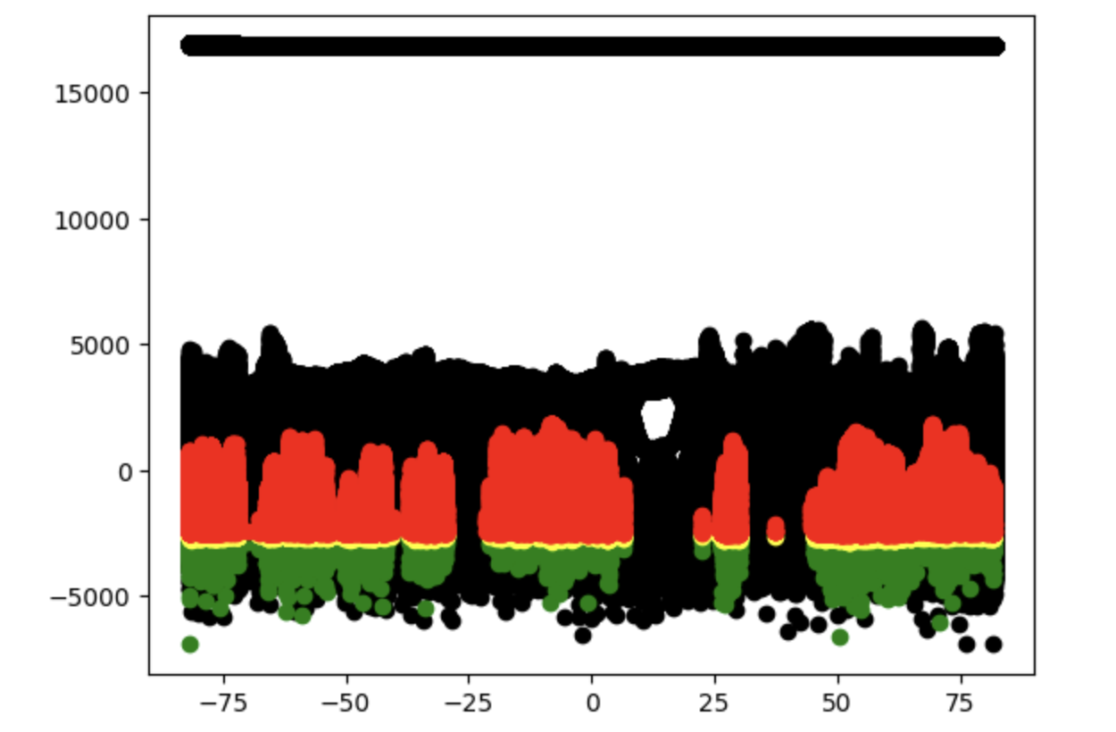
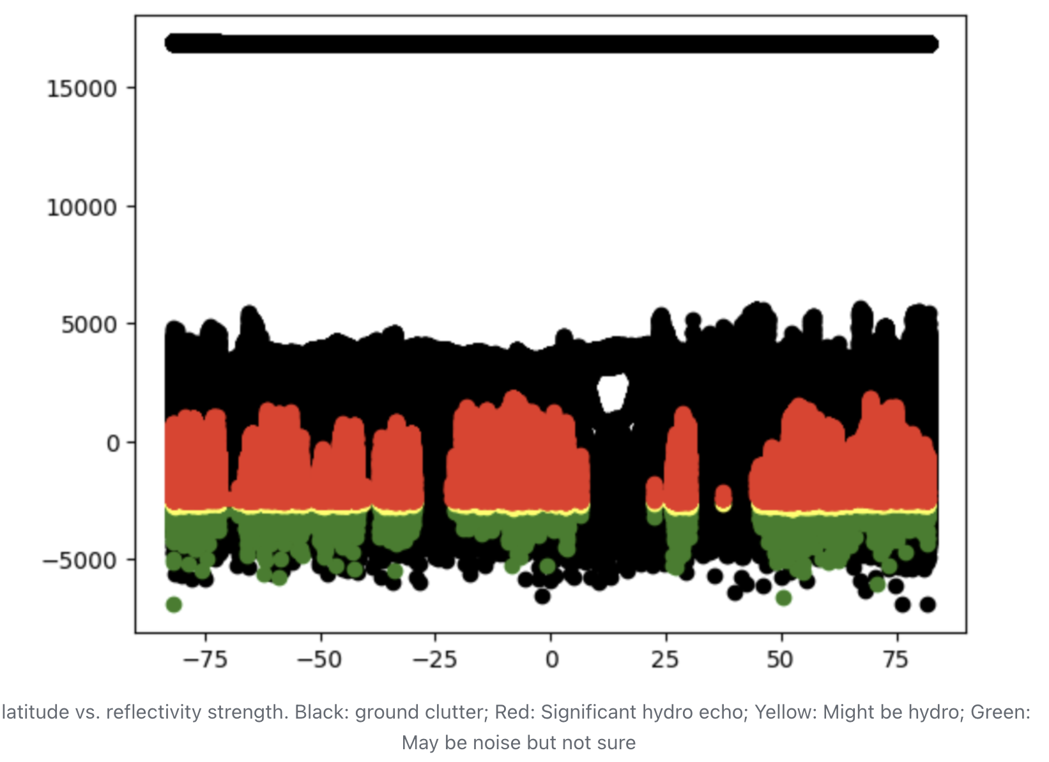
Blind zone and ground clutter
Ground clutter: Surface echos we don’t want
2~5 orders of magnitude higher than hydrometeur signals
i.e., 20~50 dBZe larger than hydro reflectivity. FYI, precip threshold ~-15dBZe

Slide 28
Blind zone and ground clutter
Ground clutter: Surface echos we don’t want
2~5 orders of magnitude higher than hydrometeur signals
i.e., 20~50 dBZe larger than hydro reflectivity. FYI, precip threshold ~-15dBZe
Blind zone: Close-to-surface altitudes full of ground clutter
Varies w.r.t. surface type/surface orography/other surface conditions
Conservatively, the lowest 5 bins (~1200m) above land, 2 bins (~500m) above water

Slide 29
How does ground clutter impact snow estimate?
CloudSat has a 2C-level snowfall estimate product: 2C-SNOW
2 sources of bias: Virga and shallow clouds:
Virga: Observed above the blind zone but evaporates before landing -> snowfall overestimation
Shallow clouds: Clouds below the blind zone -> precip not detected by CPR -> underestimation
2C-CLDCLASS-LIDAR might be helpful
Problem: Thick clouds under 1000km

Slide 30
A case study
Maahn et al., 2014
Polar regions
Event occurrence detection altered 5%
Precipitation amount underestimated by 9%~11%

Slide 31
Shallow snowfall-producing clouds
A global shallow cumuliform snowfall census (Mark et al., 2016)
Usually above large water bodies (~71%), e.g., the Great Lake region
Main reseaon: Lake-effect snow due to cold-wind outbreaks

Slide 32
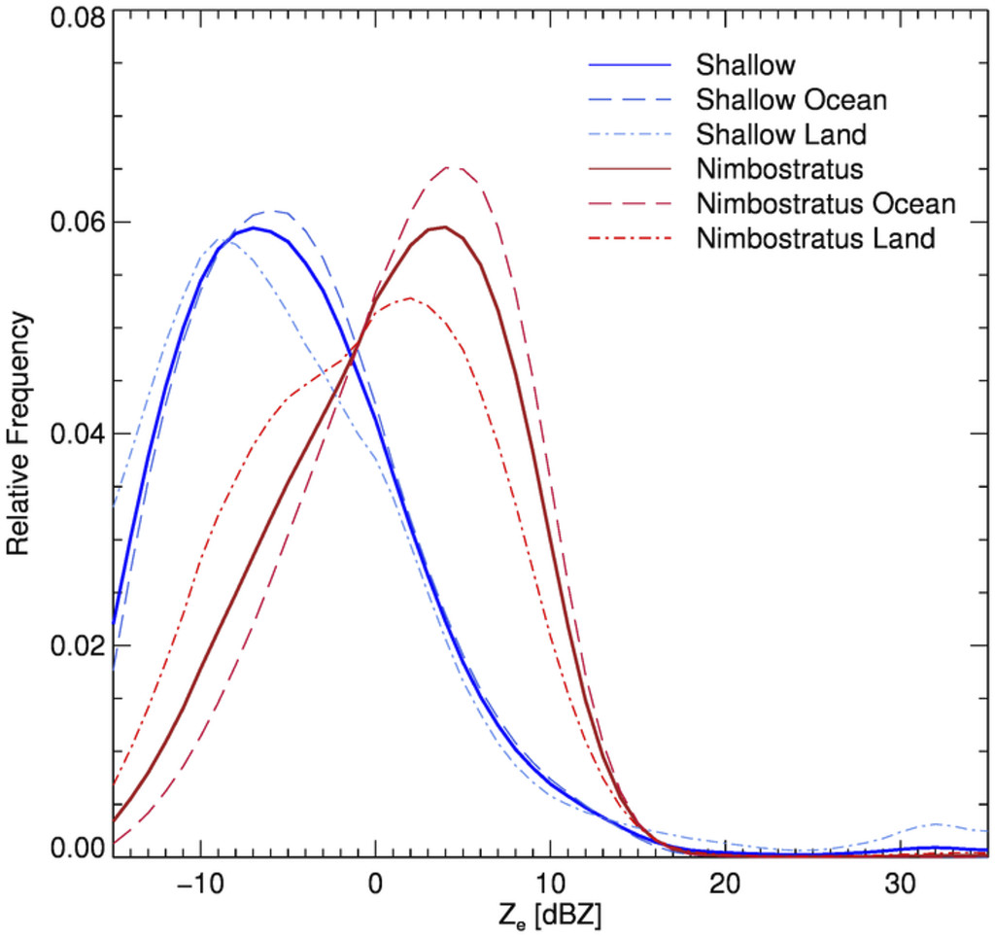
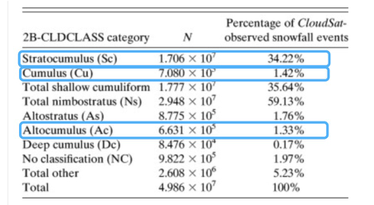

Slide 33
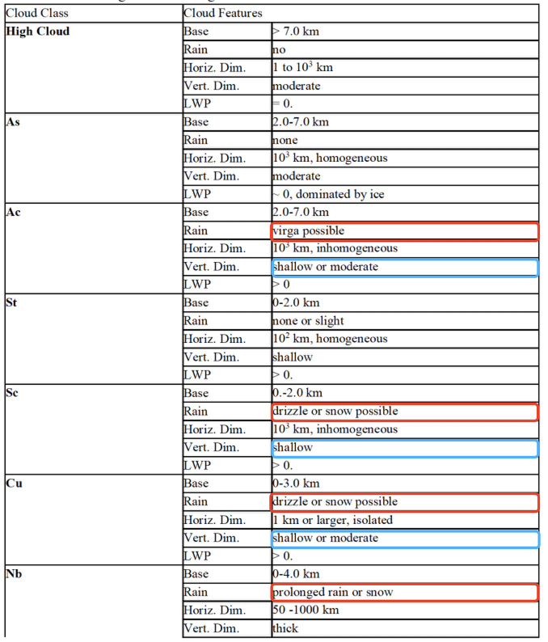

Slide 34
Data analysis workflow
Data downloading:
DPC official data ordering system
Can select based on a spatial window
Maximum a 2-month time window
SFTP server
Register on the DPC website using your SSH and IP address
No restriction on downloading, but you can’t filter your data based on any criteria, i.e., time/space window, or any attributes

Slide 35
Data analysis workflow
Data format and parsing:
HDF-EOS binary data, not readable by people
1 hdf file == observation for 1 day == 14~15 orbits
Parsing methods:
Official toolkits
Convert to HDF5 through an official tool, then use pyhdf, etc.
MATLAB
CIS, a geoscience data integration platform developed by a team from Oxford

Slide 36
Data analysis workflow
A cloud computing platform develop by myself
On manabe now
Submit a query, wait, and get the result database under /mnt/obs
2 tables: 2D-attribute table (test2d) & 3D-attribute table (test3d)
Attributes with only horizontal profiles are in the 2d table
Attributes with a vertical dimension are in the 3d table
Can do “join” operation to combine connect them

Slide 37
Data analysis workflow
Data analysis:
The whole tabular data is large: multiple GB for only one day of observation
Large-scale long-term study is challenging
You can’t read TB of data to your memory one time
Data loading is very slow
Speed benchmarking: connectorx >> hdf-file python packages > pandas
Solution to memory limitation:
Separate the data in chunks on the disk, run a for loop to load them in the memory batch-by-batch
Use pyspark or other advanced distributional computing packagesconnectorx

Slide 38
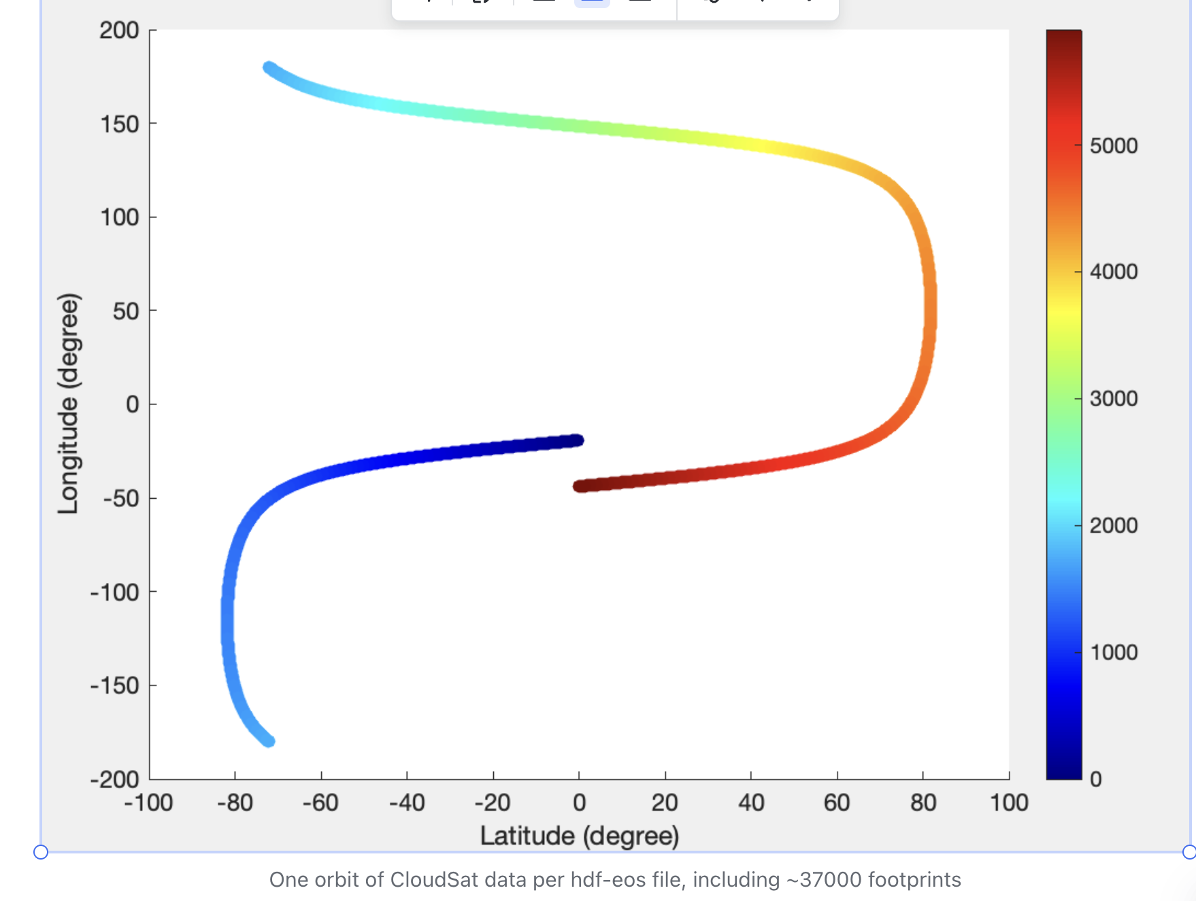
Data analysis workflow
Data visualization:
Use latitude and longitude as the 2 axes:

Slide 39
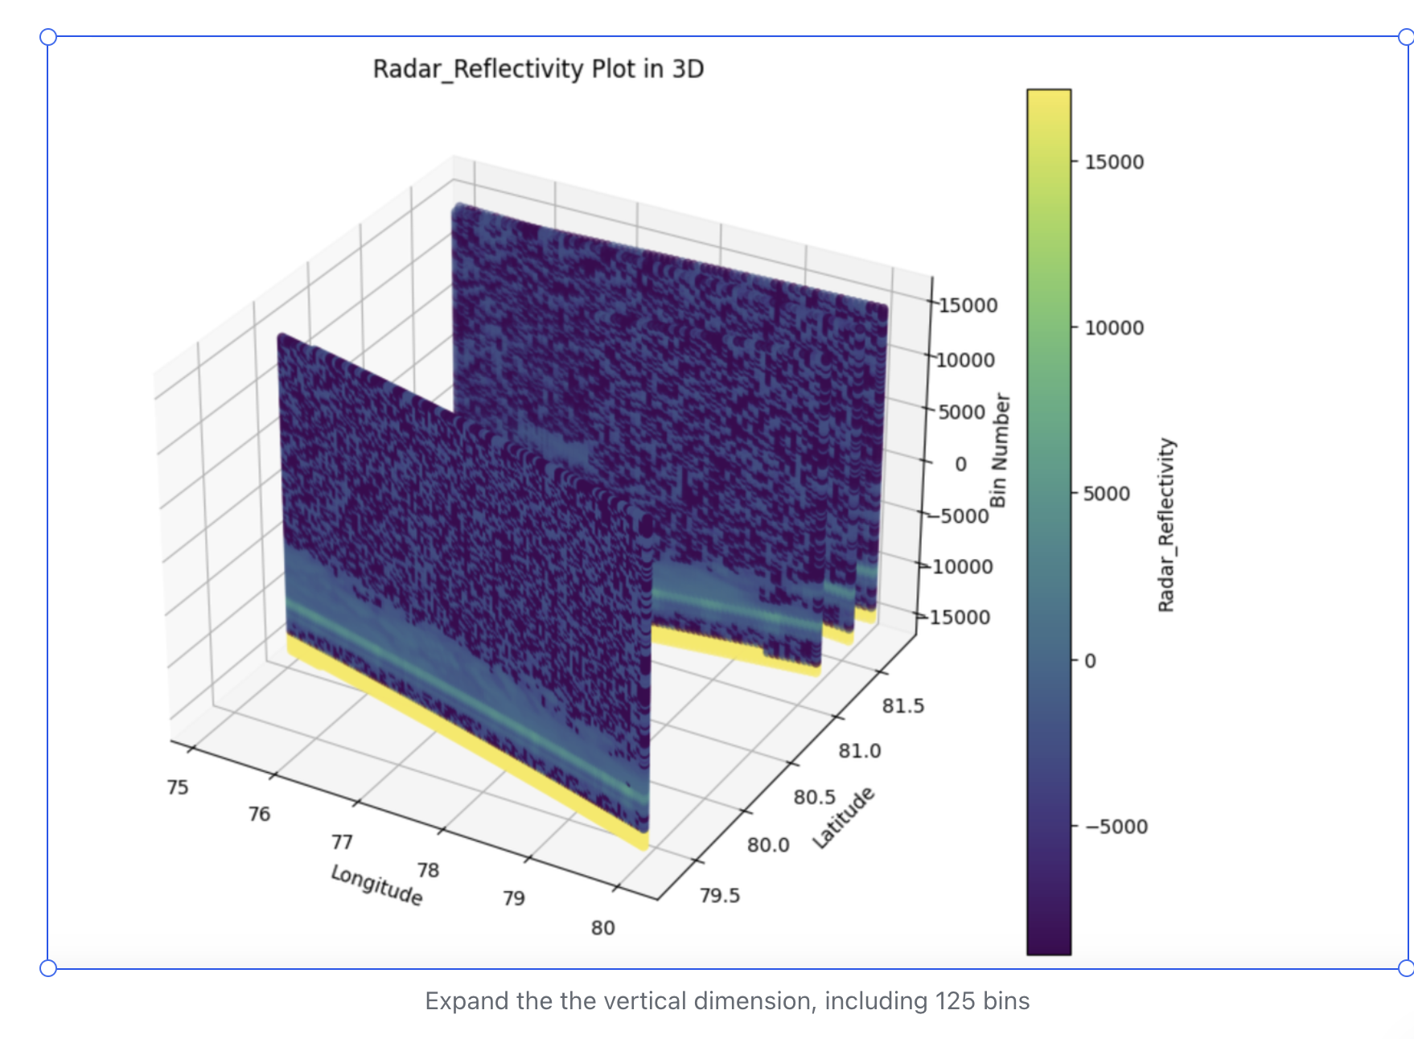
Data analysis workflow
Data visualization
For 3d attributes, naturally, the data is 3d, so we plot it in 3d:

Slide 40
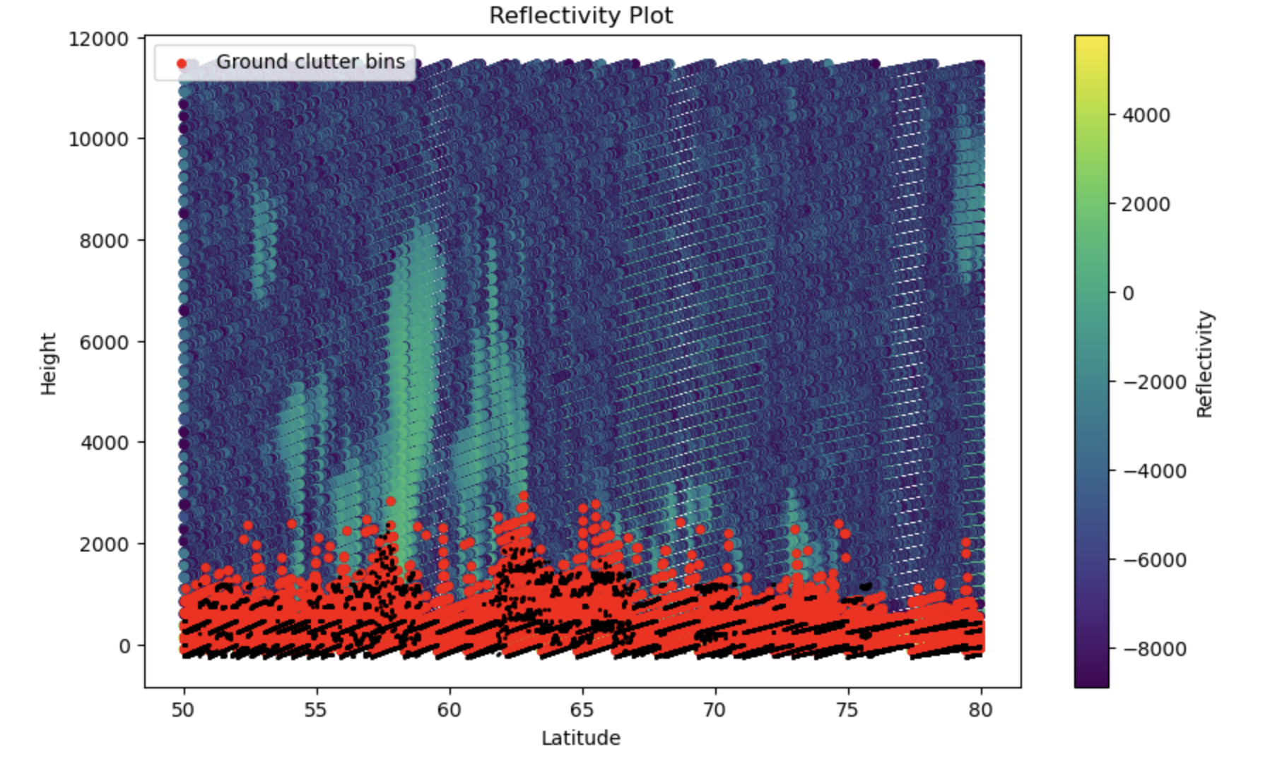
Data analysis workflow
Data visualization
But since the inclination orbit angle is close to 90, just use Height-Latitude:

Slide 41
Data analysis workflow
Data analysis:
Statistical analysis: Tabular form is just fine for mainstream DS software, e.g., python, R, MATLAB, ArcGIS

Slide 42
Data analysis workflow
Data analysis:
Image operations: Convert to raster data, e.g., tensor in mem, or geotiff on disk

Slide 43
Data analysis workflow
Summary:
Hdf-eos file
Raw data, small-size, easy to transfer
not readable, not analyzable, lack software supports
Tabular form
Intuitive numerical demonstration, can fit lots of software, easy for stats analysis
Lack spatial intuition/demonstration, too large
Image form
Intuitive spatial demonstration, can fit lots of cv & gis software, easy for spatial analysis/image processing
One attribute per channel/layer, requires tensor operations, too large

Slide 44
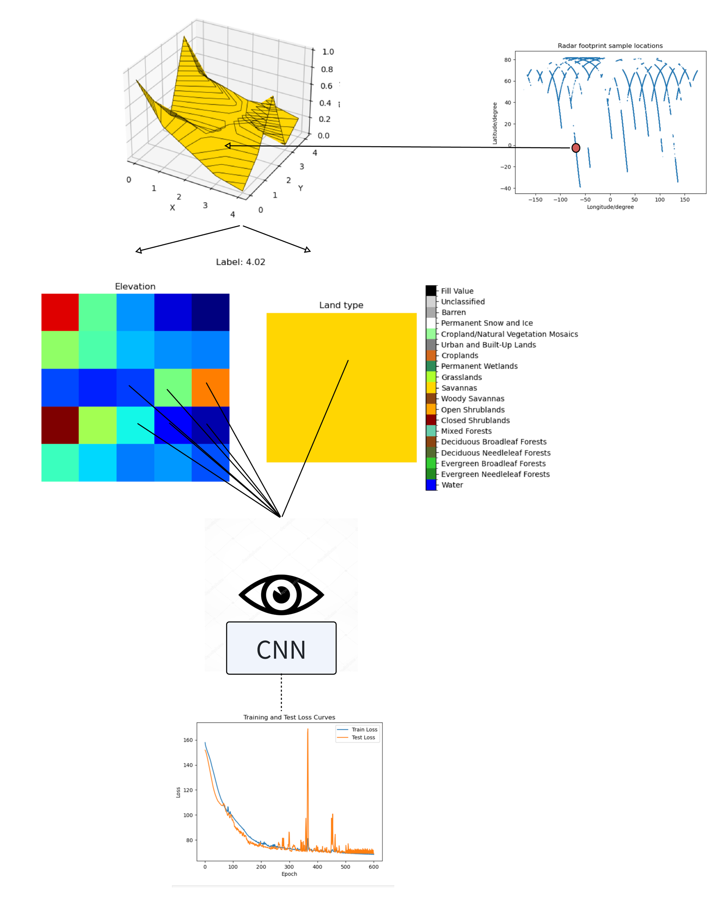
A experiment: Ground reflectivity regression using a GAM with CNN as a basis function for orography complexity representation

Slide 45
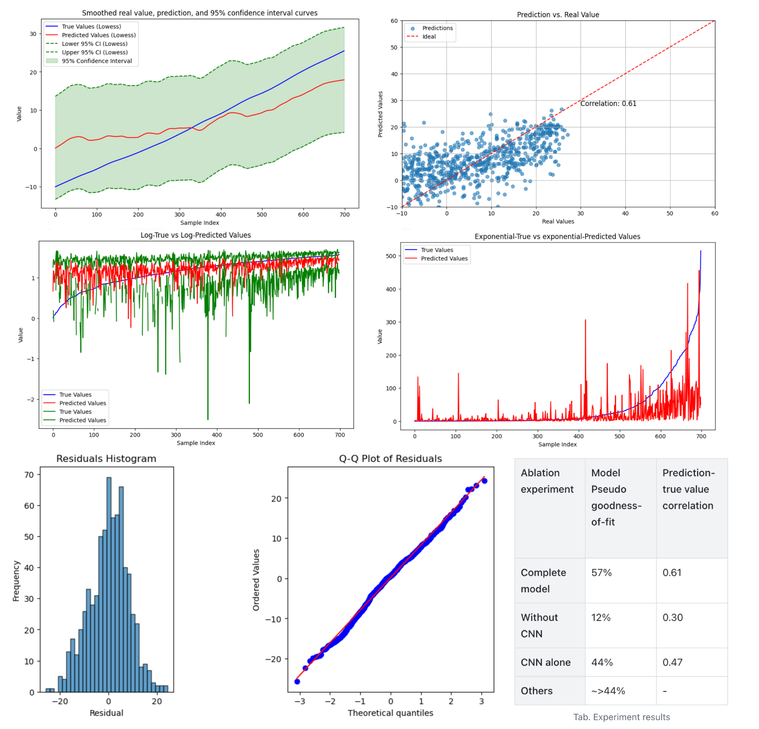
A experiment: Ground reflectivity regression using a GAM with CNN as a basis function for orography complexity representation

Slide 46
A experiment: Ground reflectivity regression using a GAM with CNN as a basis function for orography complexity representation
Some “conclusion” or insights
A CNN might indeed be used to represent the orography complexity in a ground clutter context
Pretrain a simple CNN and hold it as a basis function in a GAM, enables a confidence interval for the prediction computed in 1 second, without having to do computational inferences on thousands of parameters in CNN by 1000 times Monte Carlo to get a variational bad CI
Real-time computation can be a benefit for many apps, e.g., satellite onboard algorithm
We might study clutter-led impacts/bias for different cases:
Differentiate by orography, surface type, local climate (e.g., virga occurrence frequency), etc.
To avoid generalization issues

